Slide 1


Egyptian Space Agency
Egyptian Universities Training Satellite Project
EUTS
Anomaly Detection for Satellite Telemetry Data Using Machine Learning
Prepared by
Helwan University
Computer and Artificial intelligence–Computer Science T42

Slide 2
Introduction
Project Idea: detect of telemetry data that come from satellites with using of machine learning algorithms,
Telemetry data is set of measurement and reading of embedded device Across time interval
In this project ,we use two dataset consist of Date and Temperature records ,after preprocessing dataset we use time series and machine learning algorithm to detect future temp

Slide 3
Data Analysis

Slide 4
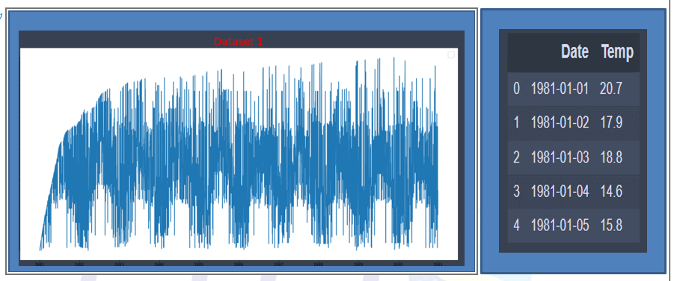
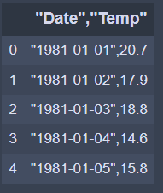
Dataset 1
dataset 1 consists of one column "Date","Temp" and we try to separate them into two columns ‘Date’ , ‘temp’

Slide 5
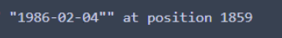
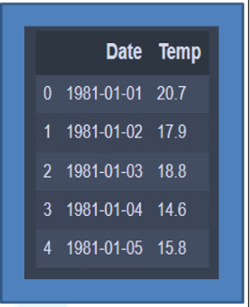
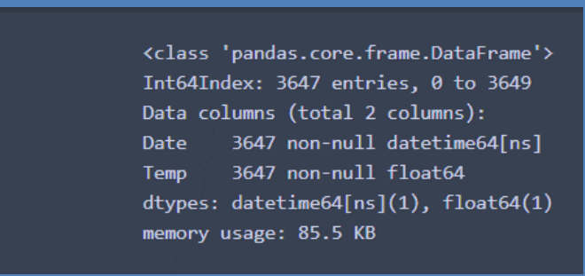
Dataset 1 Preprocessing
Dataset 1 consists of one column "Date","Temp" and we try to separate them into two columns ‘Date’ , ‘temp’
Convert temp column data type from string to float
Convert Date column data type from string to Datetime
Drop Null values and check for Duplicated
Finally data after Cleaned

Slide 6
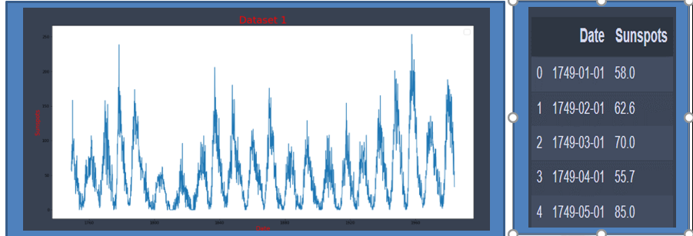
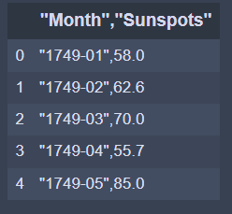
Dataset 2
dataset 2 it consists of one column "Month","Sunspots" "Date","Temp" we try to seprate this column into two column Date and Sunspots

Slide 7
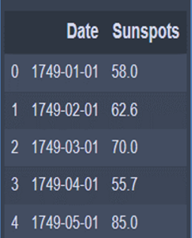
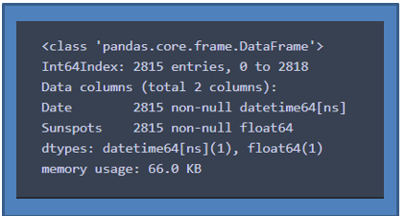
Dataset 2 Preprocessing
dataset 2 it consists of one column "Month","Sunspots" "Date","Temp" we try to separate this column into two column Date and Sunspots
convert data type for Sunspots from String to float
Convert Date column data type from string to Datetime
we found two issue at index 7 where year and month are swapped ,at index 489 invalid month
Drop Null values and check for Duplicated
Finally dataset look like

Slide 8
ARIMA Model

Slide 9

ARIMA is an that stands for Auto Regressive Integrated Moving Average.
ARIMA is an acronym that stands for Auto Regressive Integrated Moving Average. It is a generalization of the simpler Auto Regressive Moving Average and adds the notion of integration
An ARIMA model is a class of statistical models for analyzing and forecasting time series data.
Any ‘non-seasonal’ time series that exhibits patterns and is not a random white noise can be modeled with ARIMA models.
The statsmodels library provides the capability to fit an ARIMA model.
An ARIMA model can be created using the statsmodels library as follows:
Define the model by calling ARIMA() and passing in the p, d, and q parameters:
p is the order of the AR term(It refers to the number of lags of Y to be used as predictors.)
q is the order of the MA term(It refers to the number of lagged forecast errors that should go into the ARIMA Model.)
d is the number of differencing required to make the time series stationary
The model is prepared on the training data by calling the fit() function.
Predictions can be made by calling the predict() function and specifying the index of the time or times to be predicted

Slide 10
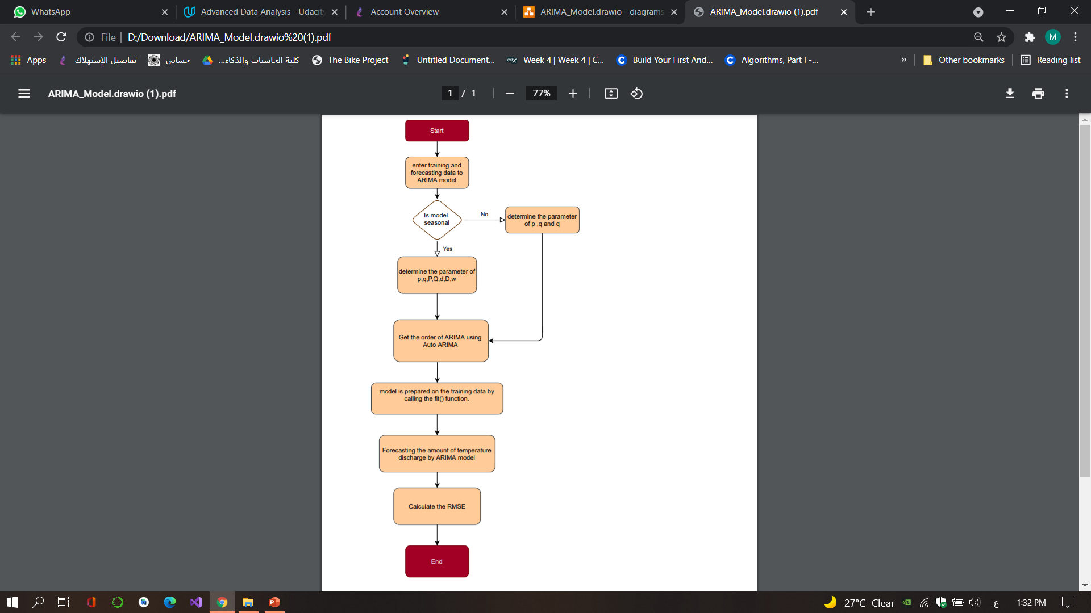
implemented in project
1-train data
2-
We use Auto ARIMA and Get
Best model(Dataset1): ARIMA(3,0,1)
Best model(Dataset2): ARIMA(3,0,2)
3- Create ARIMA Model
4-Fit the model
5-predict
6-calculate the mean square error
RMSE | 4.019 | 62.041

Slide 11
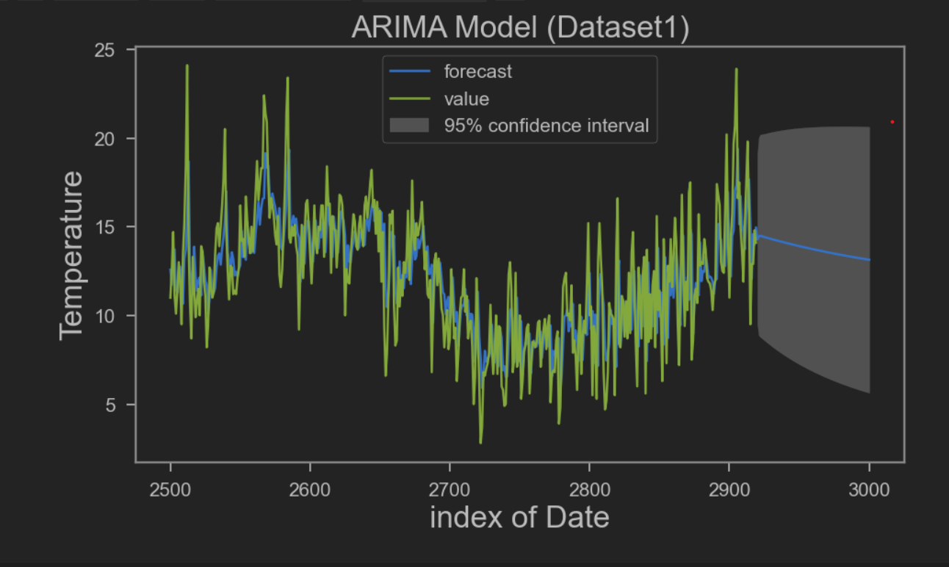
Result “Mean Square Error:4.01

Slide 12
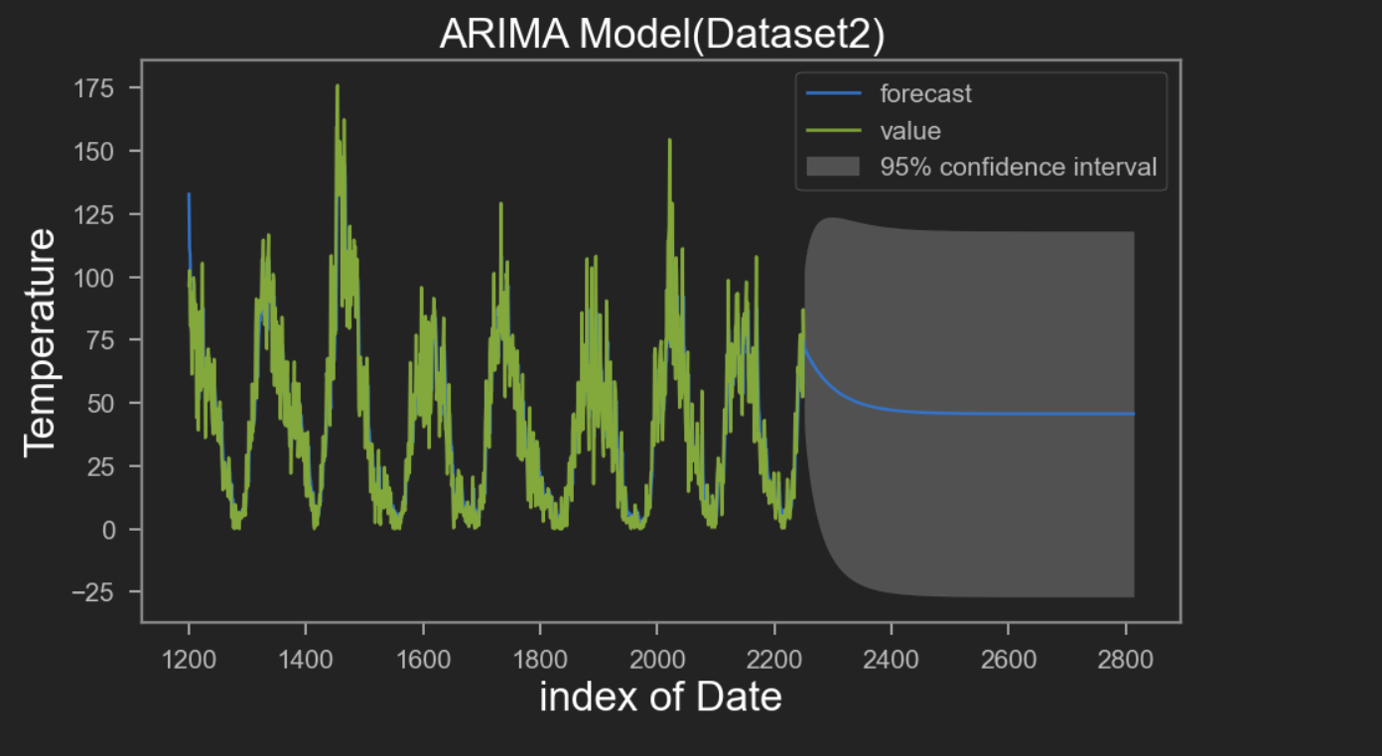

Slide 13
ARMA Model

Slide 14
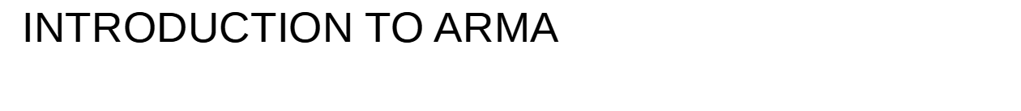
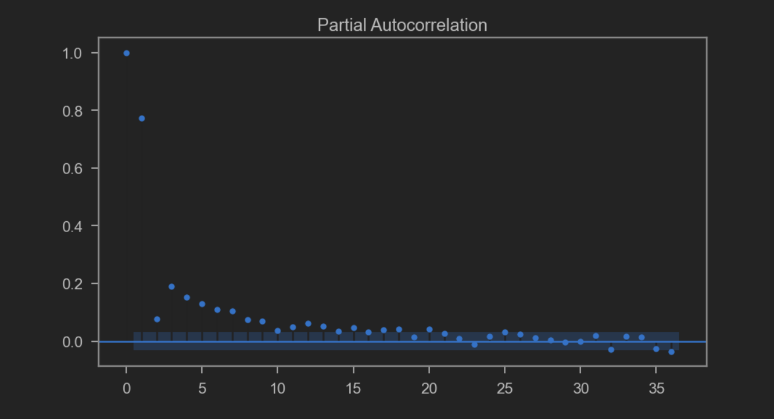
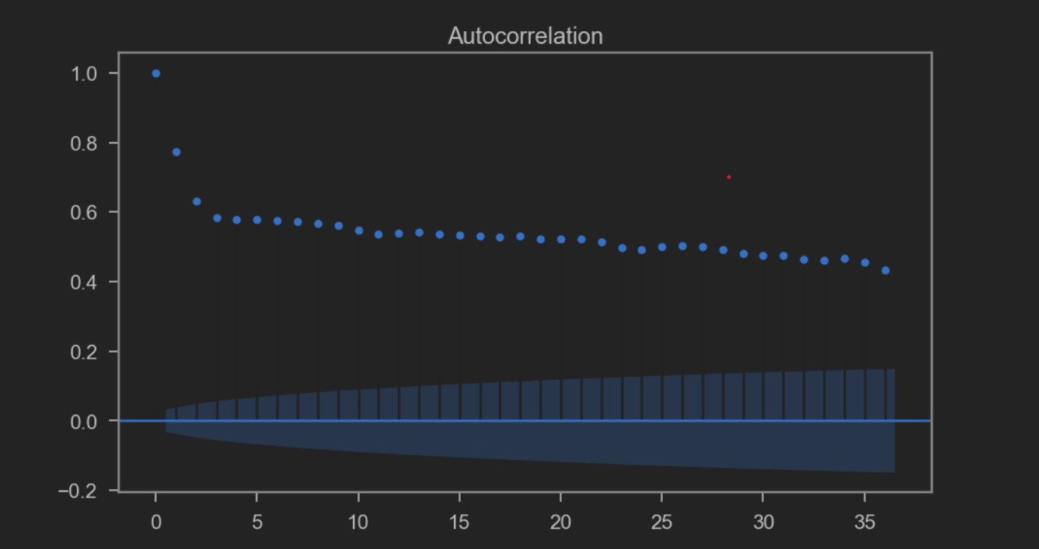
ARMA stands for Auto Regressive Moving Average.
An ARMA model is a class of statistical models used to describe weakly stationary time series.
We use ACF & PACF plots to check parameters and see if there’s a need to use differencing.

Slide 15
An ARMA model can be created using the statsmodels library as follows:
Define the model by calling ARMA() and passing in the p, d, and q parameters.
The model is prepared on the training data by calling the fit() function.
Predictions can be made by calling the predict() function and specifying the index of the time or times to be predicted
The parameters of the ARMA model are defined as follows:
p: The number of lag observations included in the model, also called the autoregressive order.
d: The number of times that the raw observations are differenced, also called the degree of differencing.
q: The size of the moving average window, also called the order of moving average.

Slide 16
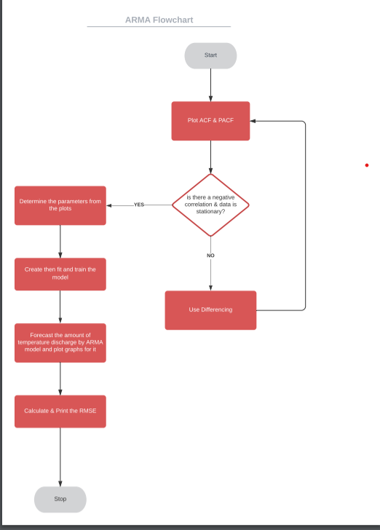
Flow chart

Slide 17
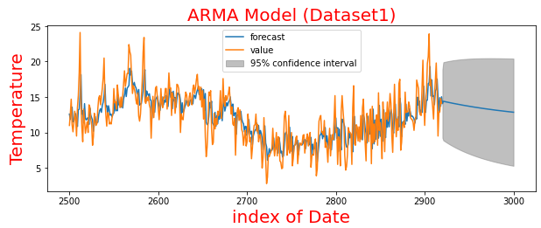
Result “Mean Square Error:3.987

Slide 18
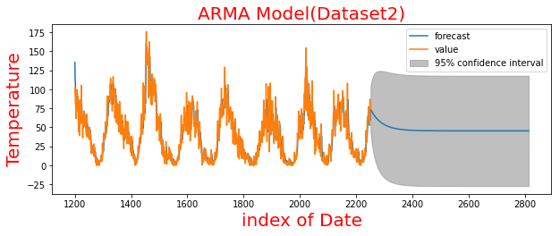
Result “Mean Square Error:62.247

Slide 19
SES Model

Slide 20
INTRODUCTION TO SES
Exponential Smoothing is an elementary and pragmatic technique used for forecasting where the forecast is made through the exponentially weighted average of prior observations.
It analyzes data from a specific period of time via providing more importance to recent data and less importance to former data
This method produces “smoothed data”, the data that has a noise removed, and allows trends and patterns to be more clearly visible.
The weight of each parameter, or decrease in weight is always determined by smoothing parameter, called as 𝜶 (alpha - single parameter/hyperparameter).
The value of 𝜶(alpha) lies between 0 to 1 such that;
𝜶(alpha)=0: signifies that future forecasted values are the average of historical data (giving more weights to historical data)
𝜶(alpha)=1: signifies that future forecast values are the results of the recent observation (giving more weights to recent observations).

Slide 21
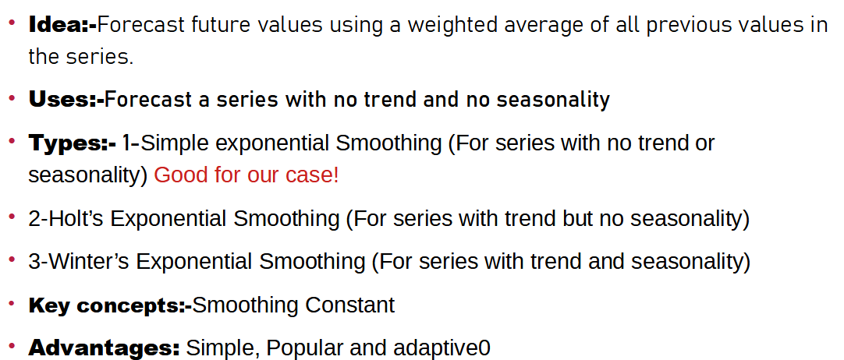

Slide 22
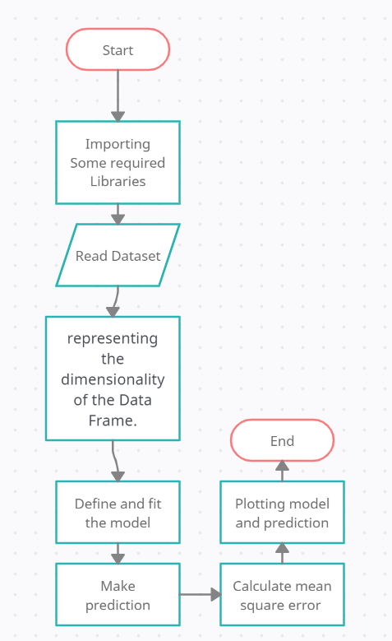

Slide 23
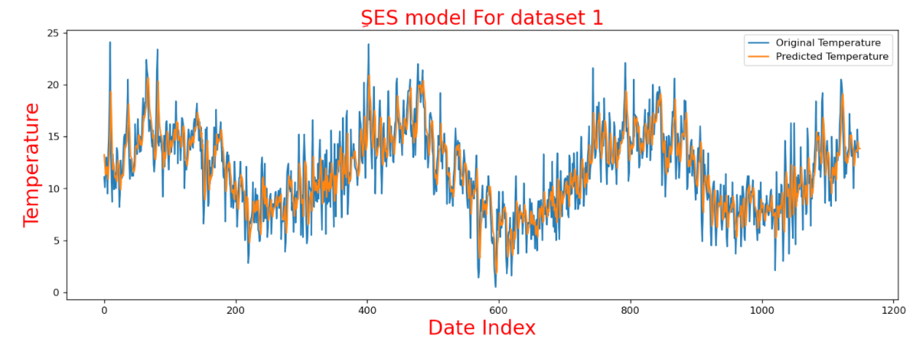
Plotted graph of first dataset
Mean_sqr_error=2.16876874275847

Slide 24
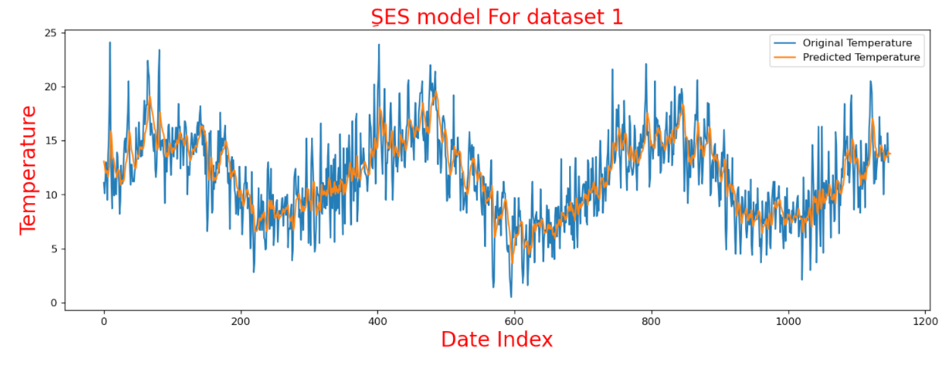
Plotted Graph of first dataset with alpha=0.2
Mean_sqr_error=2.010276443080201

Slide 25
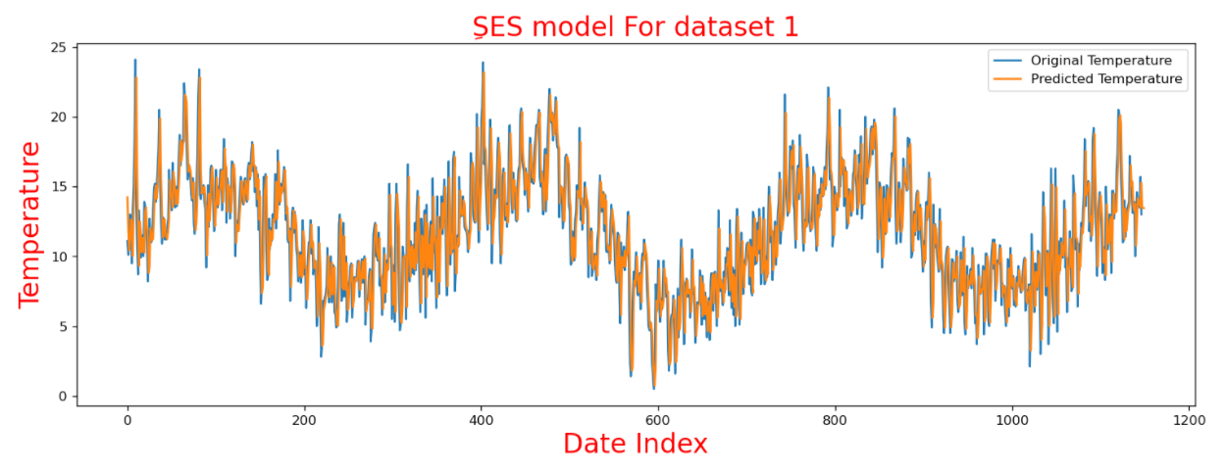
Plotted Graph of first dataset with alpha=0.8
Mean_sqr_error=2.943970631017748

Slide 26
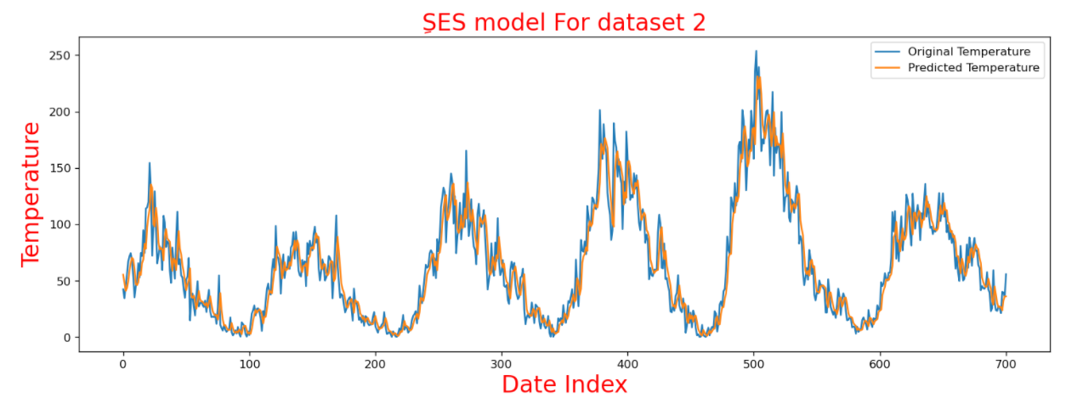
Plotted graph of second dataset
Mean_sqr_error=17.21472624307182

Slide 27
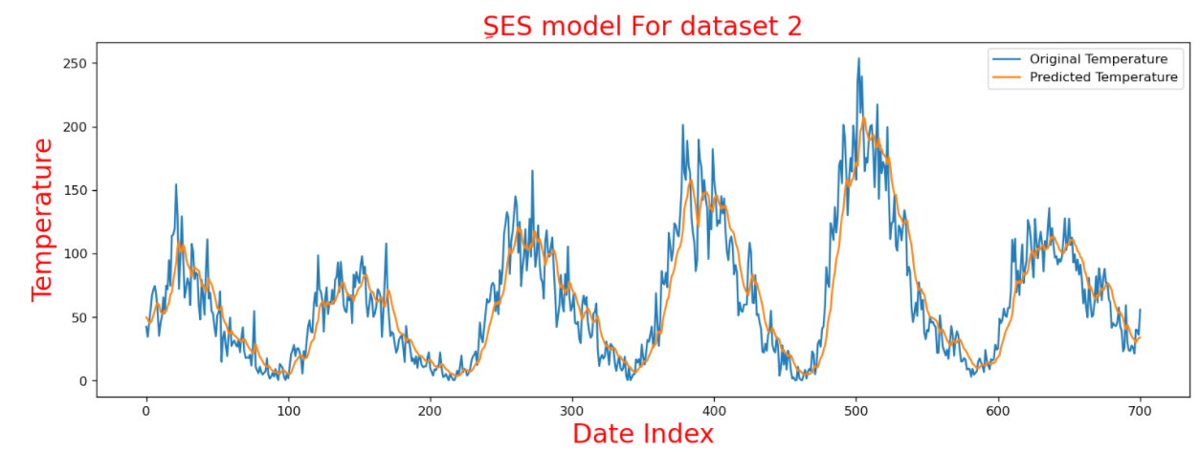
Plotted graph of second dataset with aplha=0.2
Mean_sqr_error=20.349995504549714

Slide 28
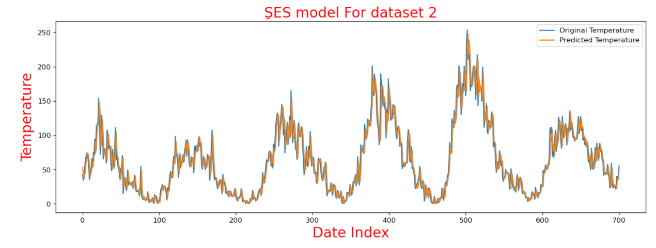
Plotted graph of second dataset with aplha=0.8
Mean_sqr_error=17.374454299005553

Slide 29
LSTM Model

Slide 30
Basic Long Short Term Memory (LSTM)
Model type
application
LSTM is a type of RNN deep learning Units that is mostly used for analysis of sequential data (time series data prediction).
There are different application areas that are used: Language model, neural machine translation, music generation, time series prediction, financial prediction, etc.

Slide 31
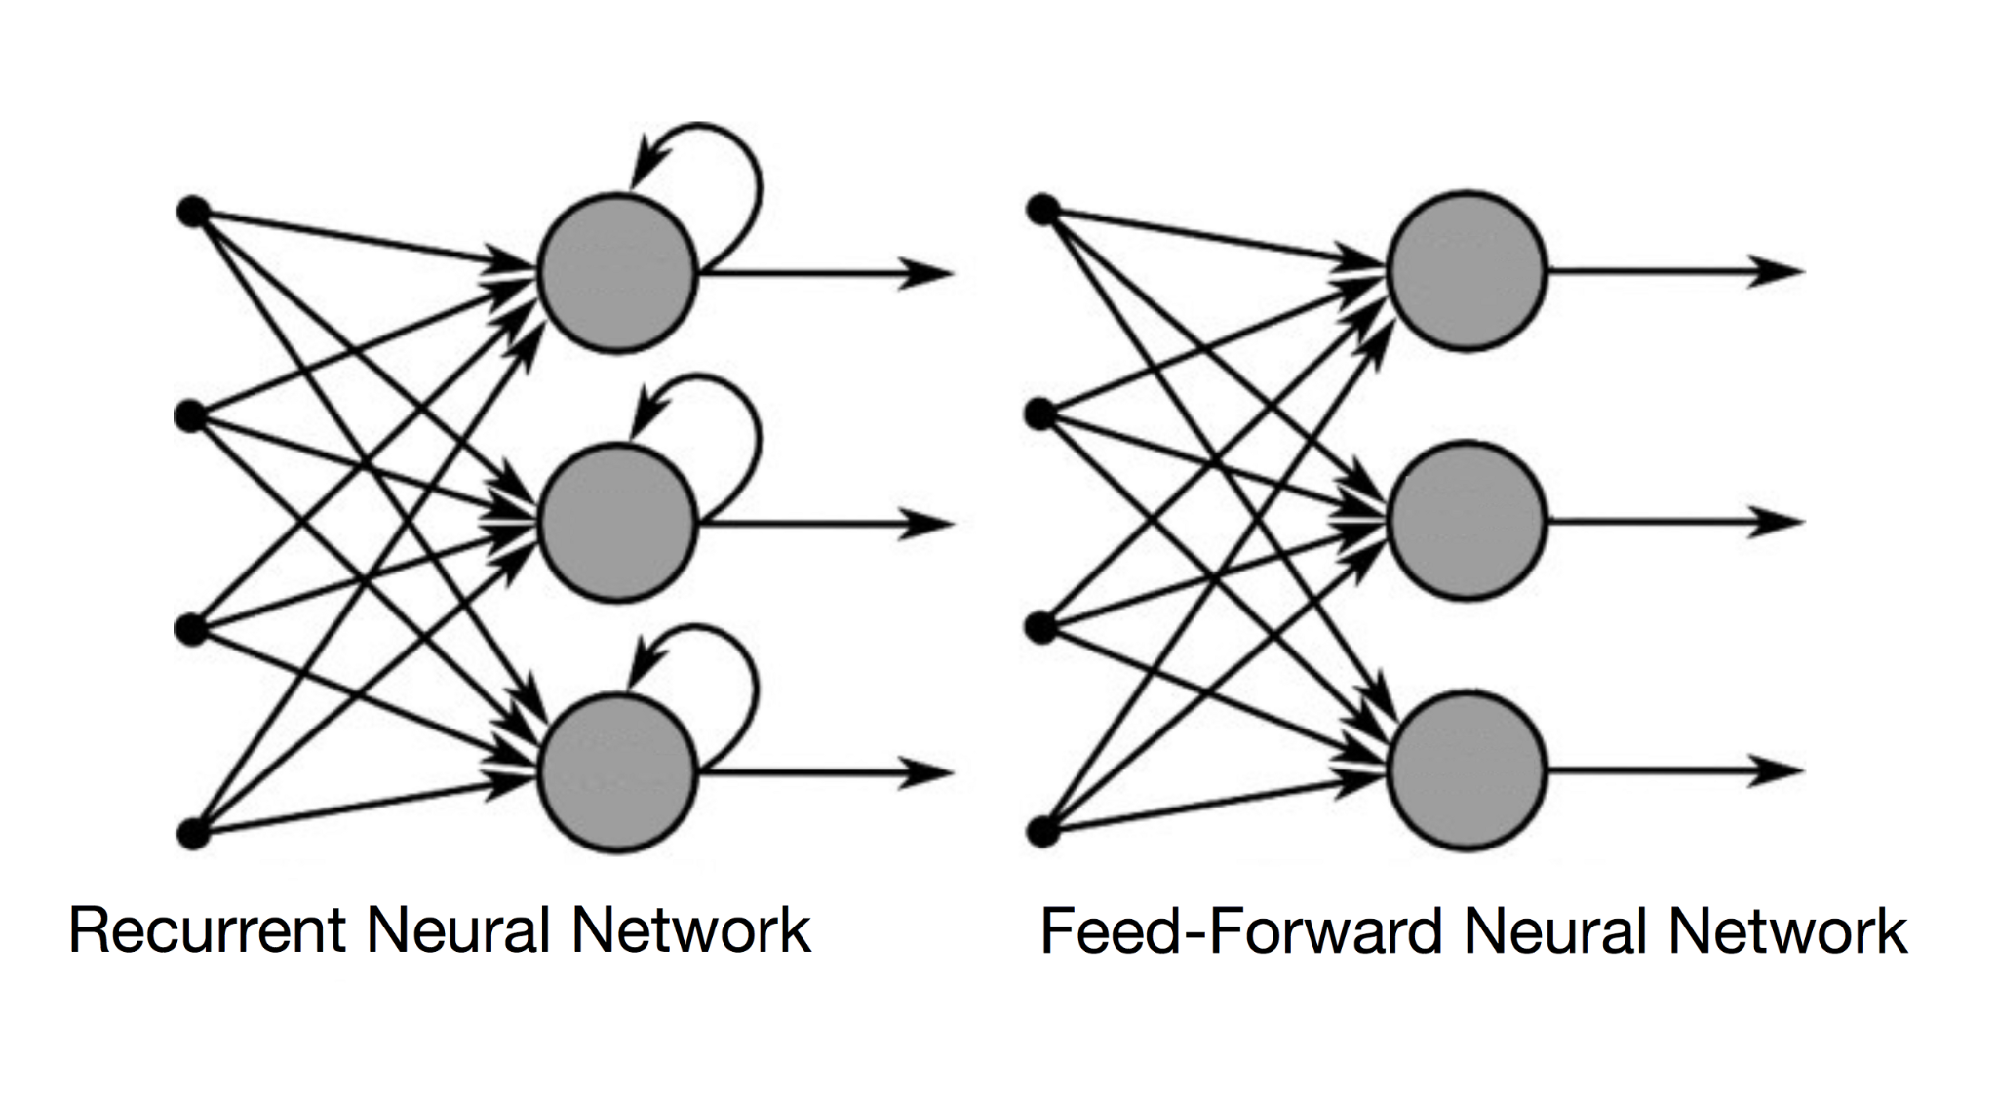
Standard NN
RNN

Slide 32
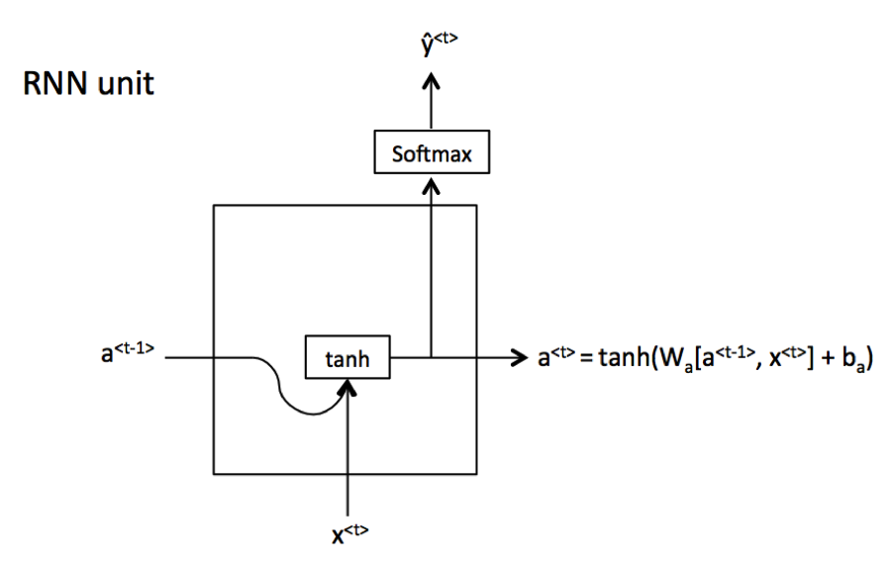
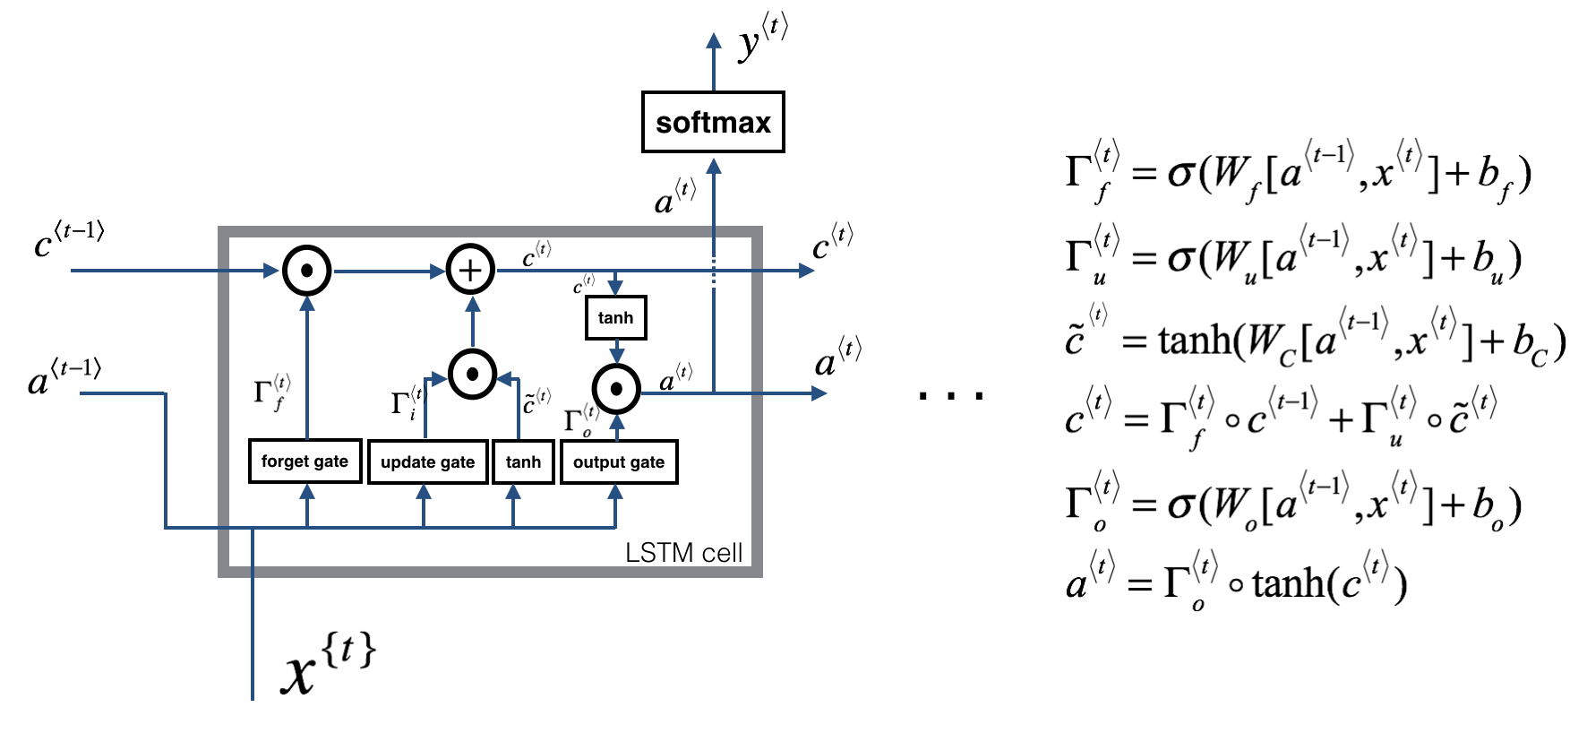
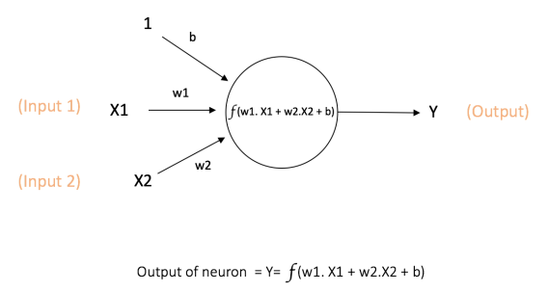
Types of NN
Standard NN
RNN
RNN with LSTM unit

Slide 33
LSTM Cell
Type of RNN units

Slide 34
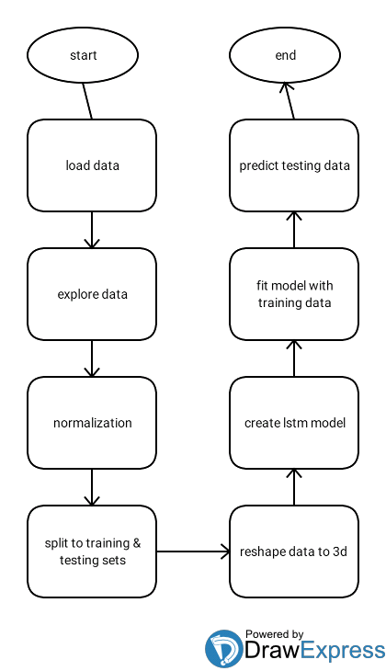
Code flow chart

Slide 35
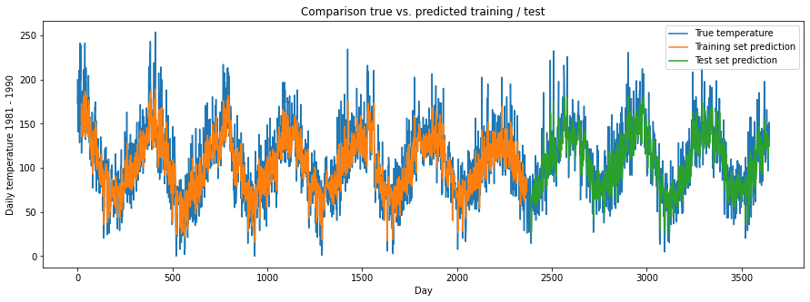
Results Dataset 1

Slide 36
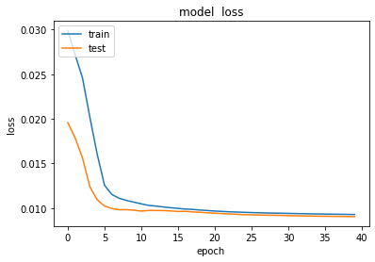
Loss
RMSE
Training data score= 23.87 RMSE
Testing data score= 23.15 RMSE

Slide 37
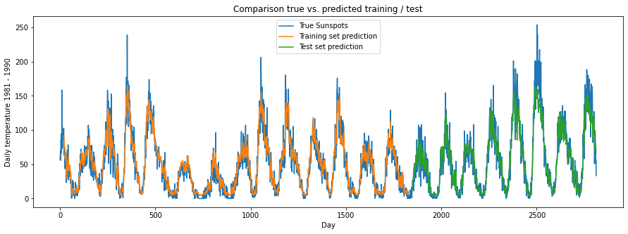
Results dataset 2

Slide 38
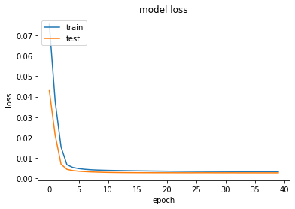
Loss
RMSE
Training data score= 13.86 RMSE
Testing data score= 18.49 RMSE

Slide 39
XGBOOST Model

Slide 40
Description
XGBoost is an efficient implementation of gradient boosting for classification and regression problems.
XGBoost can also be used for time series forecasting, although it requires that the time series dataset be transformed into a supervised learning problem first.

Slide 41
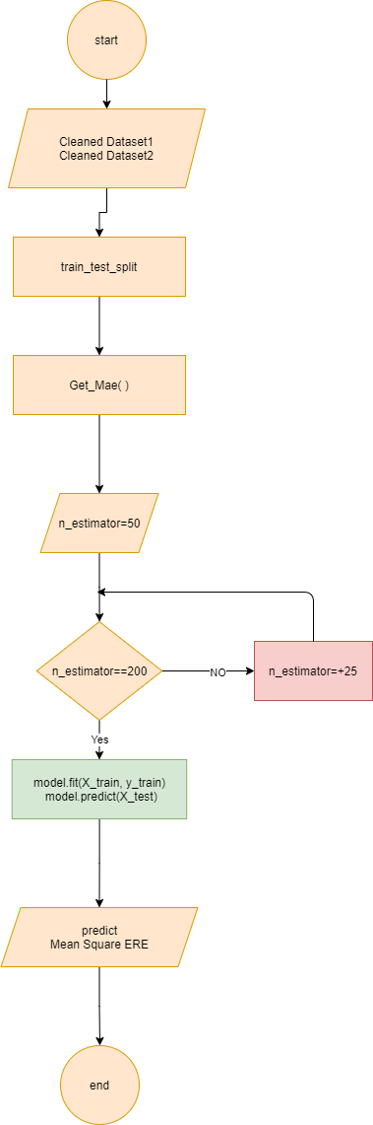

implemented in project
-First thig we Give Index Instead of Data to use XGBoost
-then, we split data to train and test with size 0.8 to train and without random state
- we try to find the best n_estimator through mean square error calculation then we select Best n_estimator for Dataset 1 is 100 and Dataset 2 is 70
-after that we predict our data and here is the prediction result on plot:

Slide 42
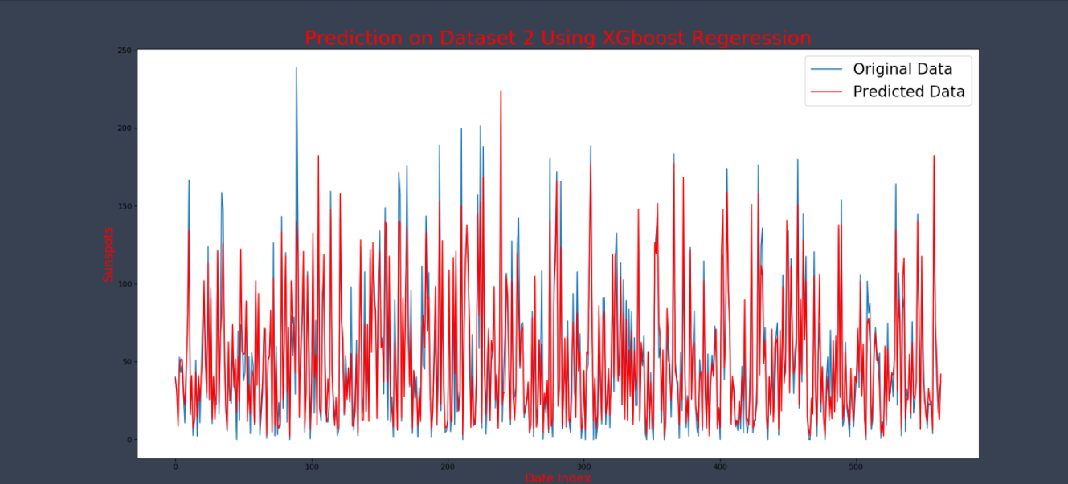
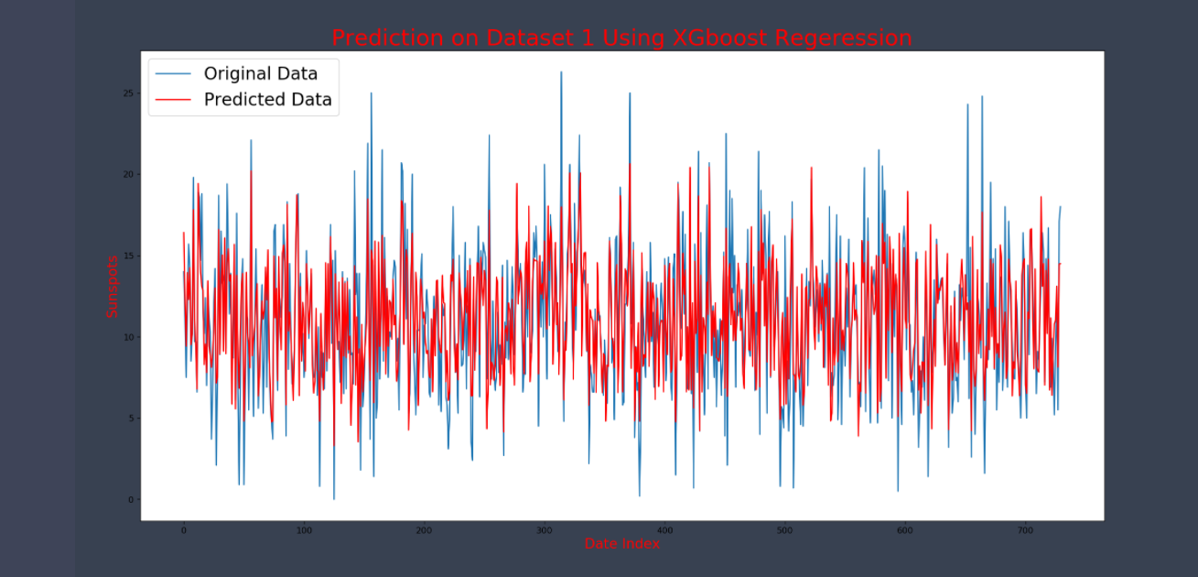

Slide 43
GRU Model

Slide 44
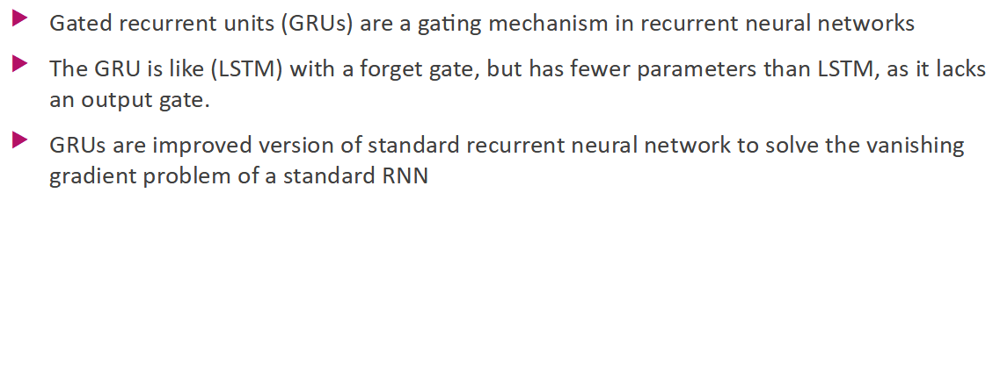

Slide 45
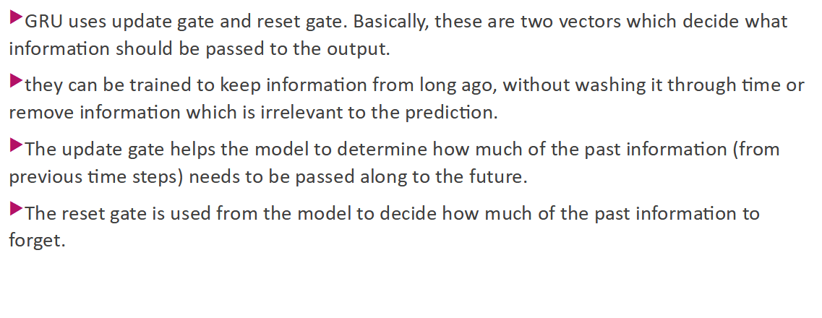

Slide 46
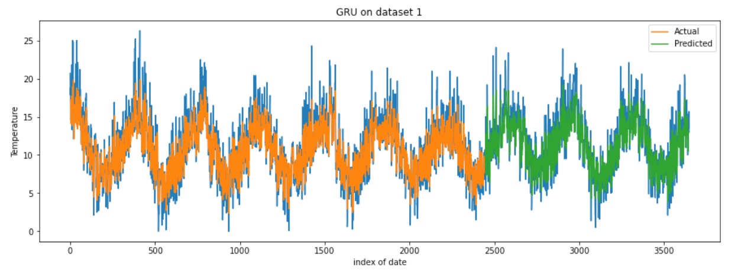

Slide 47
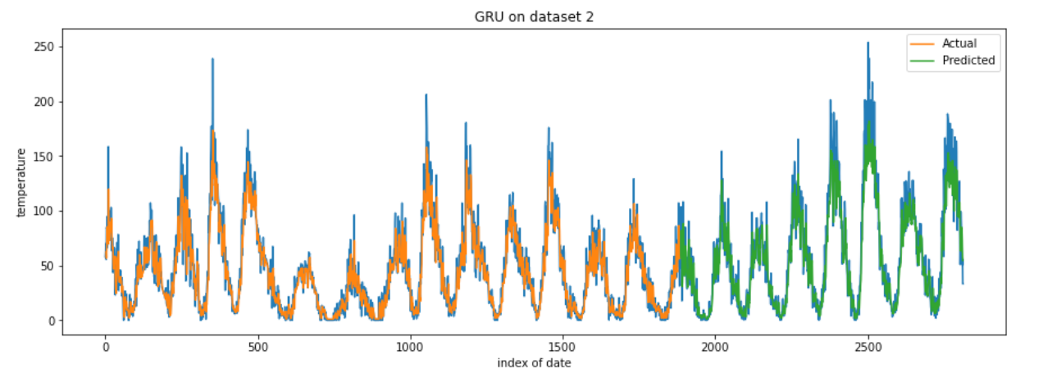

Slide 48
